Slide 1



Welcome to Hour of Code™
Welcome to
Minecraft Hour of Code™
Notes:
The following presentation is meant to be used for youth between 5-10 years old. We recommend planning for 60 minutes for this activity. Shorten the time for younger participants.
SAMPLE SCRIPT:
“Hi everyone! I’m <name>, from <organization>. Today we’re going to be doing Hour of Code with Minecraft. Hour of Code is a worldwide campaign organized by the nonprofit Code.org to show that anybody can learn the basics about code. Today, you’ll be a part of that - by learning to code using the new Minecraft Hour of Code tutorial from Microsoft. Before that, we’re going to talk a little bit about what coding is, why it matters, and why it’s such a fun activity!”
SLIDE GOAL:
To get participants excited for Hour of Code!
FACILITATOR NOTE:
Keep in mind the primary purpose of the event is for participants to engage with the tutorial. Limit the time you present accordingly. Most of the slides in this deck are designed to be shown extremely briefly, supporting a rapid and conversational presentation.
IMAGE INSTRUCTIONS FOR THIS SLIDE:
This image represents worldwide participation in Hour of Code events.

Slide 2


Let’s talk about coding
Let’s talk code!
Notes:
SAMPLE SCRIPT:
Welcome!
[Introduce yourself to the class, who you are, what you do, and if you work in the tech industry, tell them why your excited about Hour of Code]
“First, we’re going to watch a short video that shows you just how popular coding has become in the past few years, and how many awesome people, like you, have tried it!”
FACILITATOR NOTE:
The video will play automatically when you move on to the next slide.

Slide 3

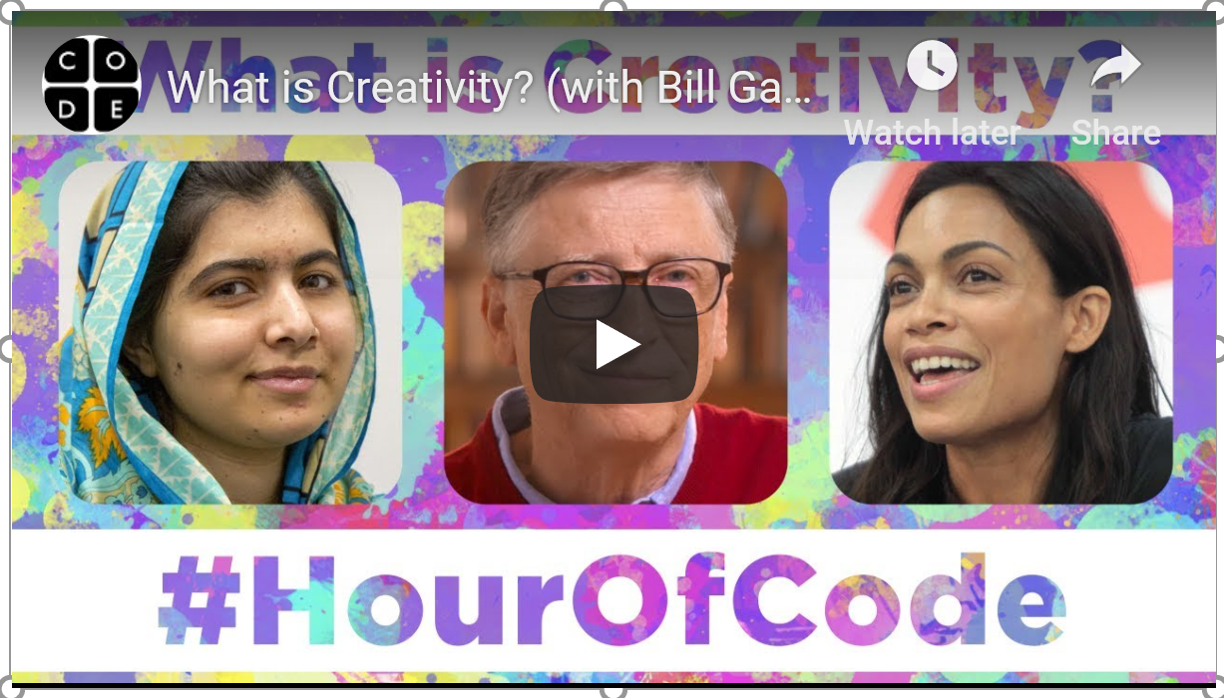
Hour of Code™ video by Code.org
Notes:
SLIDE GOAL:
To get young people excited about the Hour of Code tutorial.
IMAGE INSTRUCTIONS FOR THIS SLIDE:
The video should play automatically.
If you’d like to change the language or the subtitles, you can do so at the below link by clicking the ‘settings’ gear in the lower right hand corner of the video. You may need to re-embed the link if you do: https://www.youtube.com/watch?t=1&v=2DxWIxec6yo
Additional videos can be located at code.org, and substituted if you are looking for a different message for your audience.

Slide 4


What do you know about "coding?"
What is code?
What do you think of when you hear the word “code”?
Question
Notes:
SAMPLE SCRIPT:
“What do you think of when you hear the terms ‘code’ and ‘coding’? Is it all about secrets, like a secret code? What kind of people do you think code? Let your imagination go wild!”
SLIDE GOAL:
This slide is meant to be an ice-breaker.
There is a likelihood that the children will not have an actual answer to these questions, but these questions are meant to prompt a discussion in the room, and gauge what preconceived notions young people might have about coding. Make sure this feels like a fun conversation where it’s OK not to know the answers. In the next slide, we’ll correct any misperceptions about coding to change the participants view before we move into tutorials.

Slide 5
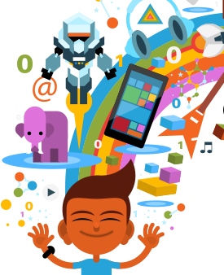
Coding is…
Coding is how apps and websites are made
Notes:
SAMPLE SCRIPT:
“Now let’s talk about what coding actually is.”
SLIDE GOAL:
Slides 5-7 are meant to explain what coding is in an easy-to-understand way.

Slide 6


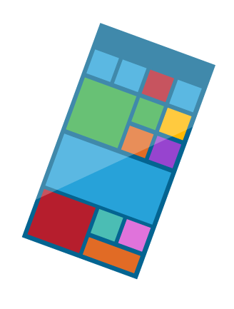

You can communicate with computers
Hello!
?
Notes:
SAMPLE SCRIPT:
“Coding is the language people use to give technology instructions so that it can do what you tell it to. You can use it to create so many wonderful things!”

Slide 7

Computers understand the language of code
</> {}
:)
Notes:
SAMPLE SCRIPT:
“In order to communicate with computers, we have to give them commands in a language that they’ll understand. That language is code!”

Slide 8

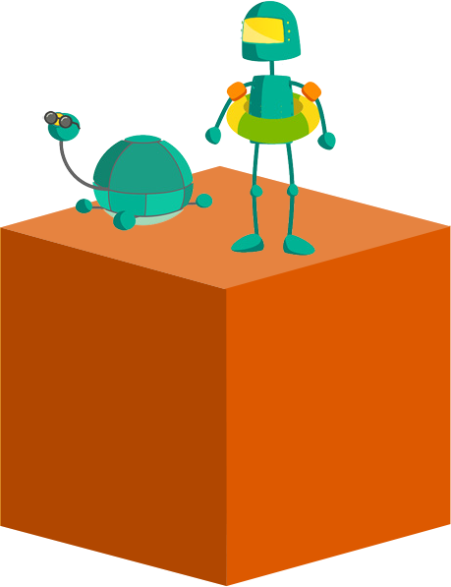
What is coding?
Coding is about…
Notes:
SAMPLE SCRIPT:
“Do you think you have what it takes to code? Great! I think so too!”
SLIDE GOAL:
Slides 9-11 are meant to explain what qualities it takes to code.
FACILITATOR NOTE
Children in this age range are concerned with learning to work with others, developing creative skills, and learning new things. It’s important to emphasize that coding incorporates all of those pieces.

Slide 9



Solving Problems
Solving problems
Notes:
SAMPLE SCRIPT:
“Coding is about solving problems! Code is used to create new things that make our lives easier! Like when you want to talk to someone that isn’t near you, you can send them a text! That’s an example of using technology to solve a problem!”

Slide 10


Using your imagination
Using your imagination
Notes:
SAMPLE SCRIPT:
“Code also lets you create new things, so it helps to be imaginative and creative!”

Slide 11


Working with friends
Working with friends
Notes:
SAMPLE SCRIPT:
“Coding is a group activity! Since everyone that codes is always solving problems and using their imaginations, they help each other out by sharing their ideas and solutions with each other!”

Slide 12
What do you like to do?
What are some
of your favorite things to do?
Question
Notes:
SAMPLE SCRIPT:
“What do you like to do? It can be anything at all– reading, playing sports, fashion, playing video games.”
SLIDE GOAL:
To position coding as a something that’s connected to interests outside of the tech space, which is more likely to get young people invested. The goal is to get their imaginations working about how they might transfer a passion they have towards into a coding project that could help further that passion.
FACILITATOR NOTE: Ask your participants to share their passions and ideas

Slide 13
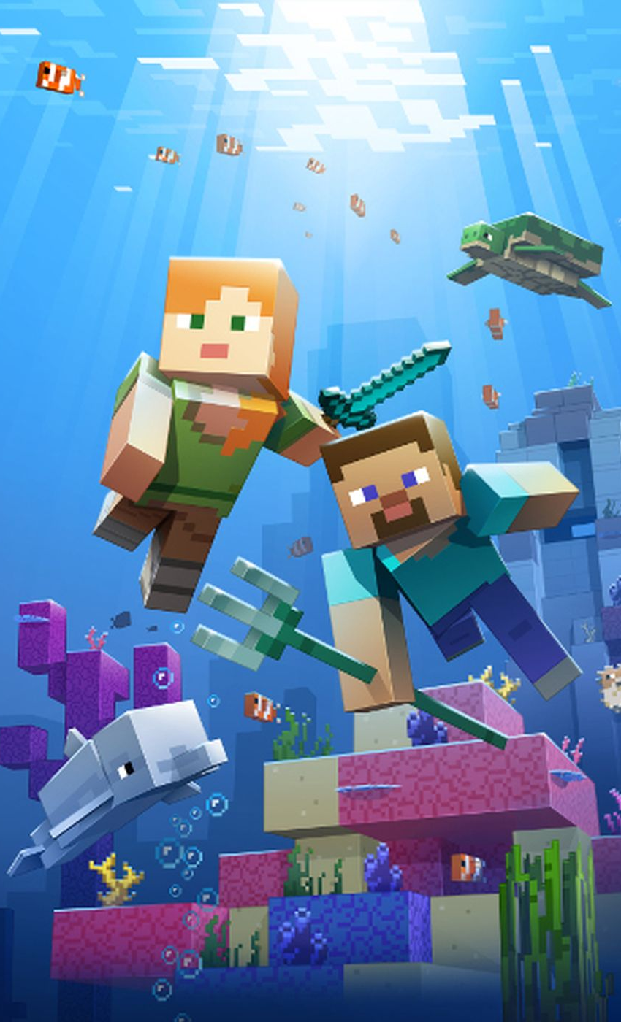
How it goes down
Minecraft Hour of Code:
Voyage Aquatic
Notes:
SAMPLE SCRIPT:
“Are you ready to start coding? Let’s get started! “For today’s Hour of Code, we’re going to learn with a Minecraft game-inspired tutorial! The tutorial uses characters and concepts from the Minecraft video game, but it is not the game itself. In the Minecraft Hour of Code tutorial, you will head underwater and will learn and use coding techniques like loops and conditionals to design your own solutions as you explore by land and by sea.
SLIDE GOAL:
To introduce Hour of Code
FACILITATOR NOTE:
There is more than one Minecraft tutorial. Start with this year's tutorial and utilize the other tutorials, if they finish early. Each tutorial teaches different concepts so doing all of the tutorials is a great idea!
If you cannot give each participant their own device, try and pair them up with someone and have them rotate every step of each lesson so they both get a chance to be active and observe. We suggest individuals work alone on the puzzles.
After fifteen minutes, congratulate the group for the progress made and the code they have written.
For participants who complete the tutorial and/or are more advanced, invite them to play through the tutorial rescuing turtles along the way, these are secondary and more challenging objectives on some of the levels
Finally, for those who want to shortcut the Hour of Code, Puzzle 4 heads straight to some levels about loops and Puzzle 7 heads straight to levels focused on conditionals

Slide 14
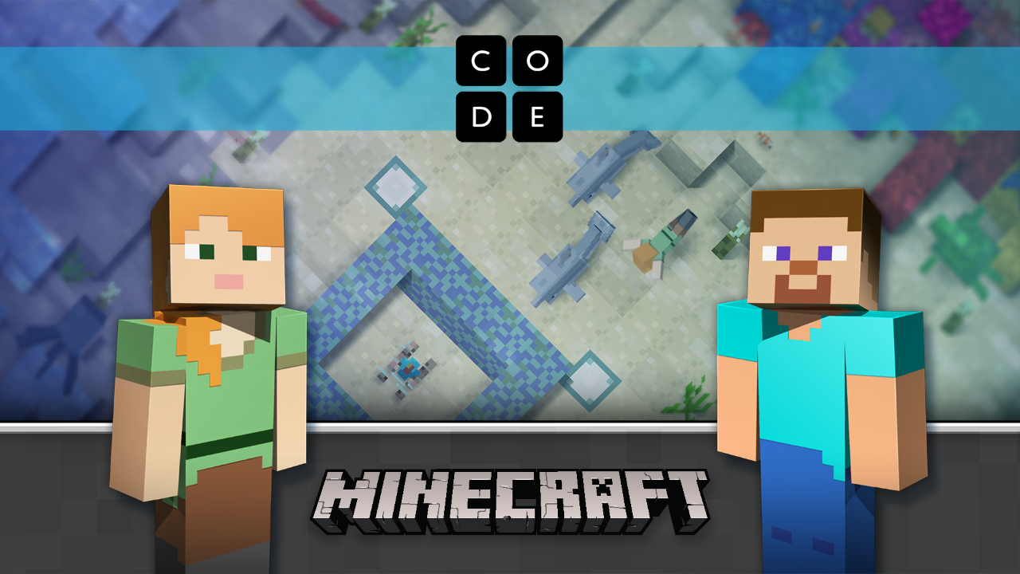
Find your tutorial
Find the tutorial at Code.org/Minecraft
Notes:
SAMPLE SCRIPT:
“Now go to code.org/Minecraft to find the “Minecraft Hour of Code Voyage Aquatic” tutorial and BEGIN! ”
SLIDE GOAL:
To give people time to get to the tutorial.
FACILITATOR NOTE:
Keep this slide up during the tutorial, and proceed to the next slide only once your group nears the end of their tutorial
If participants sign into the tutorial, progress will be saved on the levels and they can come back if they don’t finish.
Since there is free play and space to construct anything one wants, be aware of the risks associated with youth and user generated content.
IF YOU HAVE LIMITED TIME:
Complete as many puzzles as you can. Tech savvy kids may complete them all in 50-60 minutes.
Congratulate the students for what they accomplished, and let them know they can do coding again from home.
IF YOU HAVE EXTRA TIME:
Direct students to continue to create on the final puzzle for additional hours of playability.
Direct students to go back through each of the puzzles, and challenge them to solve the puzzles in a different way. This reinforces fun and interesting opportunities for iteration and experimentation.
Direct students to play through the previous three Minecraft Hour of Code tutorials.

Slide 15
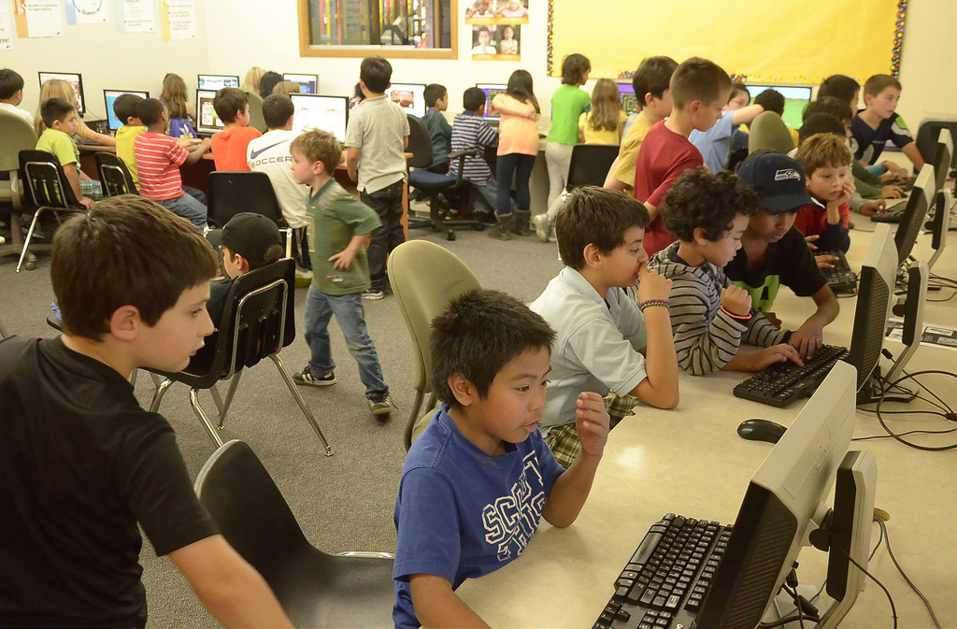
Make coding part of what you love
By learning to code, you can learn how to make your favorite activities more fun with the help of computers!
Notes:
SAMPLE SCRIPT:
“Coding can be a part of all of the things you like to do!”
*EXAMPLES TO MENTION
People that like movies can build an app where people rate and talk about them
Someone that likes video games can build their own game
Someone that likes sports can build an app that shows stats of their favorite team
If someone likes cartoons and superheroes, they can make a website about their favorite characters
SLIDE GOAL:
To emphasize that not only will they find new ways to have fun in the process of coding and discovering what they can do with coding, but that the stuff they end up creating can be something they can share and use with friends.

Slide 16


Wrap up
Wrap up
Notes:
SAMPLE SCRIPT:
“Alright everyone! You only have five more minutes to finish up!
[if access to devices and internet is common add] And remember, you can continue learning to code with Minecraft later.”
SLIDE GOAL:
To alert participants that time is almost up and the tutorial is almost over.

Slide 17
Now what do you think about coding?
Now that you’ve tried a tutorial: what is code?
Discussion
Notes:
SAMPLE SCRIPT:
“Let’s go back to the conversation we had earlier. Have your thoughts on what coding is changed?”
How will you answer the question “What is code” if your family or a friend asks?
What did you learn?
What was most difficult for you? What did you do when you got stuck? Why is that important? [encourages persistence]
How is coding creative? [connect coding to another way of being creative, like singing, dancing, building.]
Who is coding for? [working to get beyond myths like boys, those good at math, etc.]
What are some ideas for how you could use code to create something amazing?
SLIDE GOAL:
To return to the initial question, and to see how the children’s opinions on coding have changed. This question is a recap for the students to gain confirmation that what they picked up and what they did during the session is actually accurate. It gives them the reinforcement and certainty that the inferences they made are actually correct, which helps them internalize what they learned.

Slide 18

You did it!
Notes:
SLIDE GOAL: To end the workshop on a high note.
SAMPLE SCRIPT: “Congratulations! You’ve completed this year’s Hour of Code!”

Slide 19

Thanks for joining!
Thank you for joining
Minecraft Hour of Code
© Code.org, 2018. Code.org®, the CODE logo and Hour of Code® are trademarks of Code.org
Mojang © 2018. "Minecraft" is a trademark of Mojang AB
© 2018 Microsoft Corporation. All rights reserved.
Notes:
SAMPLE SCRIPT:
SLIDE GOAL:
To conclude event
IMAGE INSTRUCTIONS FOR THIS SLIDE:
If this image is to be swapped out, make sure it fits the following criteria:
Contains males and females
Shows the participants having a good time
Contains a group of people, not just individuals
Copyright 2017:
This presentation is licensed, not sold. You may not copy, adapt, modify, prepare derivative works of, distribute, publicly display, sell or use this content for commercial purposes without the express prior written consent of Microsoft Corporation.
This presentation is provided to you "as-is". Microsoft makes no warranties, express or implied. Information and views expressed in this presentation, including URL and other Internet Web site references, may change without notice.
Some examples depicted herein are provided for illustration only and are fictitious. No real association or connection is intended or should be inferred.
You may use this presentation for your personal use, and with classrooms and students as part of code.org and other coding events. This presentation does not provide you with any legal rights to any intellectual property in any Microsoft product.
Microsoft and the trademarks listed at http://www.microsoft.com/en-us/legal/intellectualproperty/trademarks/en-us.aspx are trademarks of the Microsoft group of companies. All other marks are property of their respective owners.
© Code.org, 2016. Code.org®, the CODE logo and Hour of Code® are trademarks of Code.org
Mojang © 2016. "Minecraft" is a trademark of Mojang AB
© 2016 Microsoft Corporation. All rights reserved.

Slide 20

Next steps
What can you learn next?
It doesn’t have to end here!
Below are steps you can take to celebrate, keep learning, and have more fun!
1
2
3
Get your cert.
Play more.
Learn more.
Congrats! You did it! You’ll find your certificate at the end of the tutorial.
Upload your code into Minecraft: Education Edition to see your code come to life in the real game!
Explore additional resources at Microsoft.com/
digitalskills
Notes:
SAMPLE SCRIPT:
“Now that you’re on your way to being a coding expert, here are a few free resources for you to check out! Make sure to write down these links, and keep coding!”
SLIDE GOAL:
To encourage young people to take a next step with coding.
FACILITATOR NOTE:
Participants may access their Hour of Code certificates at any time after they have started their Hour of Code tutorial, and after their Hour of CodeTM event, at code.org.
Adjust what is put on additional resource slide by appropriateness for audience:
Participants can upload their code into Minecraft: Education Edition and/or Minecraft on Windows 10 if available.
Participants can use Code Studio to import their code into the real game – and watch their code come to life!
Explore Minecraft: Education Edition:
Minecraft: Education Edition is built for schools, and comes with classroom management tools, lesson plans, and more. For more information, visit https://education.minecraft.net.
Explore ways to bring digital skills, from digital literacy to computer science education, to your community https://Microsoft.com/digitalskills
Code.org (https://code.org/educate) Go beyond an Hour of Code with Code.org's tools for educators. You don't need any experience to start teaching computer science in your classroom. Code.org offers curriculum, lesson plans, high quality professional learning programs, and tons of great tools for all grade levels—everything you need, all at no cost. Go to code.org/educate and choose your grade level to get started!
Code Studio (https://studio.code.org) Did you have fun during the Hour of Code? The world of computer science has a lot more to explore! Code Studio features puzzles, games, and courses for all ages. Learn how to make your own games and apps, and then share them with your friends. Go to studio.code.org and start today!

